Slide 1

Generation
Hung-yi Lee 李宏毅
Notes:
Difficulty of GAN
Convergence of GAN
Application of naïve model? -> TBD
Quality of HW
FID is the best
假人臉新創: https://buzzorange.com/techorange/2020/03/13/regium-fake/
Is it possible to describe spec norm

Slide 2

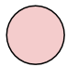
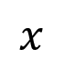
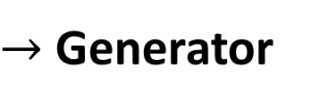
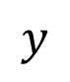

Network as Generator
$$x$$
Network
Simple Distribution
$$y$$
$→$ Generator
Complex Distribution
$$z$$
We know its formulation, so we can sample from it.
Notes:
New input z which is a random variable
You may be confused about how to add z.

Slide 3
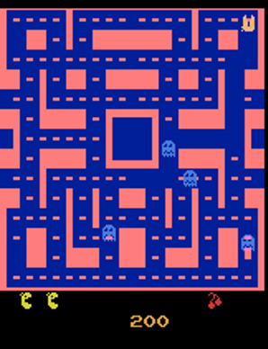
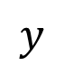
Why distribution?
Source: https://github.com/dyelax/Adversarial_Video_Generation
Video Prediction
Network
$$y$$
Previous frames
next frame
Real Video
Notes:
Not all the problem can be solved by a function.
This world has randomness. Nothing is sure. We are lack of some information to make decision.
You may be confused about how to add z.

Slide 4
Why distribution?
Source: https://github.com/dyelax/Adversarial_Video_Generation
turn
right
Video Prediction
Network
$$y$$
???
Previous frames
turn
left
Prediction
Notes:
Not all the problem can be solved by a function.
This world has randomness. Nothing is sure. We are lack of some information to make decision.

Slide 5

Why distribution?
Source: https://github.com/dyelax/Adversarial_Video_Generation
Video Prediction
Network
Previous frames
$$z$$
Prediction
Simple Distribution
Notes:
Z can be directly added to the input.
Z can be drop out …
===
For example, binary distribution

Slide 6

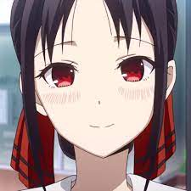
Why distribution?
(The same input has different outputs.)
Especially for the tasks needs “creativity”
Drawing
Character
with red eyes
Network
Chatbot
她是秀知院學生會 …
你知道輝夜是誰嗎?
Network
她開創了忍者時代 …
Notes:
Example:
Drawing
Chatbot

Slide 7
Generative Adversarial Network (GAN)

Slide 8

GAN
How to pronounce “GAN”?
Google 小姐

Slide 9
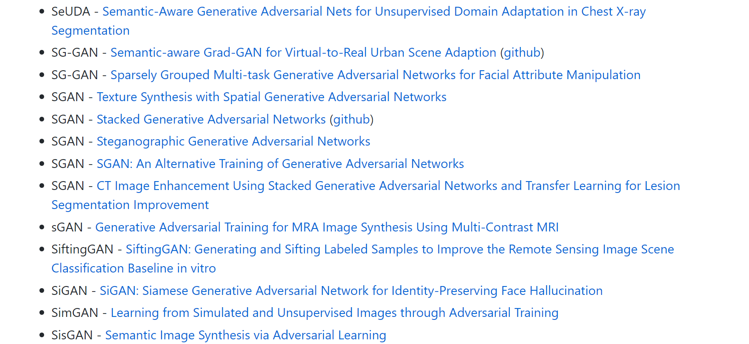

All Kinds of GAN …
https://github.com/hindupuravinash/the-gan-zoo
GAN
ACGAN
BGAN
CGAN
DCGAN
EBGAN
fGAN
GoGAN
……
Mihaela Rosca, Balaji Lakshminarayanan, David Warde-Farley, Shakir Mohamed, “Variational Approaches for Auto-Encoding Generative Adversarial Networks”, arXiv, 2017
Notes:
DeepMind

Slide 10
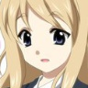

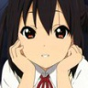


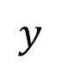



Anime Face Generation
Unconditional generation
Low-dim
vector
$$x$$
$$\left[\begin{aligned}0.3 \\ −0.1 \\ ⋮ \\ −0.7\end{aligned}\right]$$
$$\left[\begin{aligned}0.1 \\ −0.1 \\ ⋮ \\ 0.7\end{aligned}\right]$$
$$\left[\begin{aligned}−0.3 \\ 0.1 \\ ⋮ \\ 0.9\end{aligned}\right]$$
Generator
$$y$$
Complex Distribution
$$z$$
Normal Distribution
high-dim
vector
Notes:
You define the dimension! How to determine your dim???
===
We will control what to generate latter. $→$ Conditional Generation

Slide 11

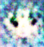
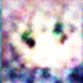
Discriminator
It is a neural network (that is, a function).
Discri-minator
image
Scalar: Larger means real, smaller value fake.
Discri-minator
Discri-minator
1.0
1.0
Discri-minator
Discri-minator
0.1
0.1

Slide 12
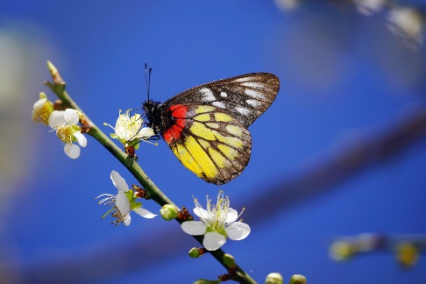
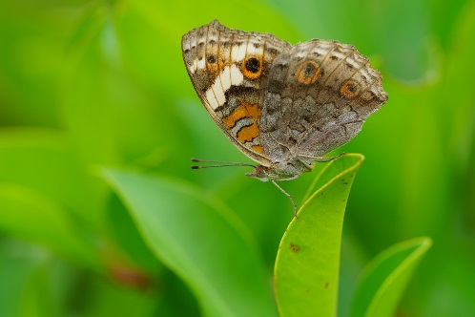
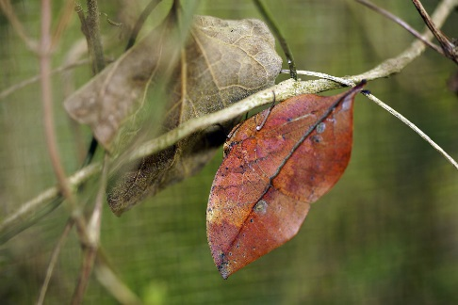
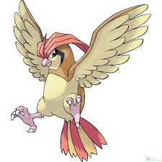
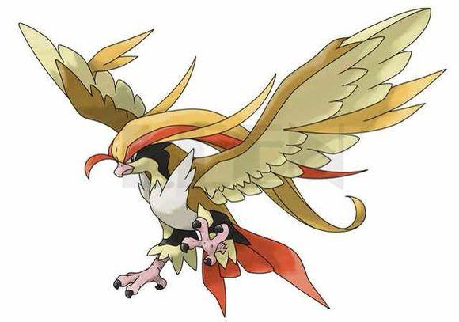
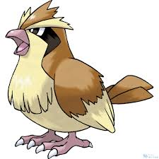
Basic Idea of GAN
Generator
Brown
veins
Butterflies are not brown
Butterflies do not have veins
……..
Discriminator
Notes:
http://peellden.pixnet.net/blog/post/40406899-2013-%E7%AC%AC%E5%9B%9B%E5%AD%A3%EF%BC%8C%E5%86%AC%E8%9D%B6%E5%AF%82%E5%AF%A5
Kallima inachus
Vein
dried leaf

Slide 13
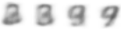
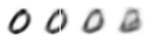
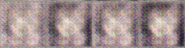
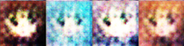
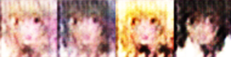

Basic Idea of GAN
This is where the term “adversarial” comes from.
NN
Generator
v1
NN
Generator
v2
NN
Generator
v3
Discri-minator
v1
Discri-minator
v2
Discri-minator
v3
Real images:
Notes:
Binary
Classifier

Slide 14
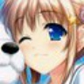



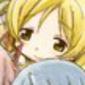


Algorithm
G
D
Initialize generator and discriminator
In each training iteration:
Step 1: Fix generator G, and update discriminator D
sample
Update
1
1
1
1
D
generated objects
Database
0
0
0
0
randomly sampled
G
vector
Fix
vector
vector
vector
Discriminator learns to assign high scores to real objects and low scores to generated objects.

Slide 15
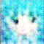
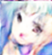
Algorithm
G
D
Initialize generator and discriminator
In each training iteration:
Step 2: Fix discriminator D, and update generator G
Generator learns to “fool” the discriminator
hidden layer
NN
Generator
Discri-minator
0.13
vector
update
fix
large network

Slide 16
Algorithm
G
D
Initialize generator and discriminator
In each training iteration:
Sample some real objects:
Update
1
1
1
1
Learning
D
D
Generate some fake objects:
0
0
0
0
G
vector
fix
vector
vector
vector
Learning
G
image
G
image
D
1
vector
image
vector
vector
vector
image
update
fix

Slide 17
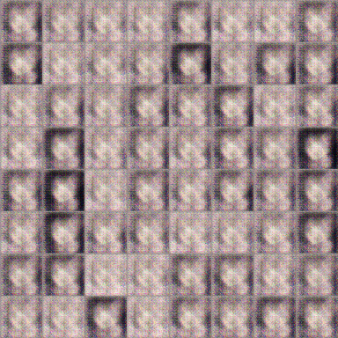
Anime Face Generation
100 updates
Source of training data: https://zhuanlan.zhihu.com/p/24767059

Slide 18
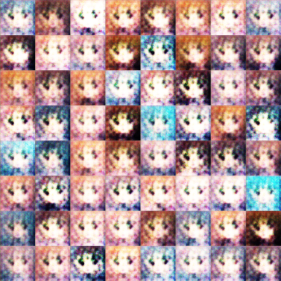
Anime Face Generation
1000 updates

Slide 19
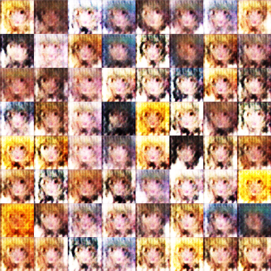
Anime Face Generation
2000 updates

Slide 20
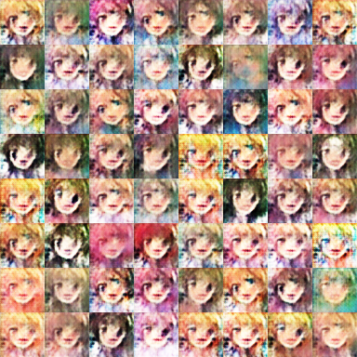
Anime Face Generation
5000 updates

Slide 21
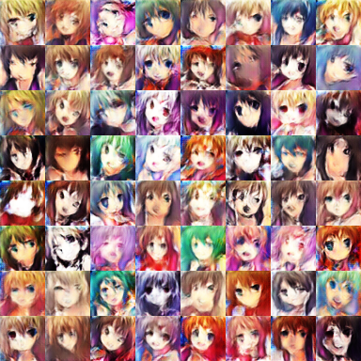
Anime Face Generation
10,000 updates

Slide 22
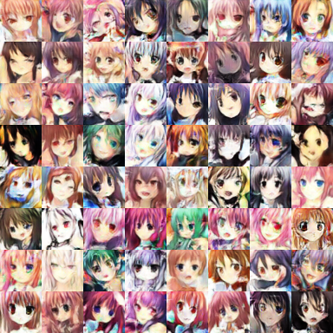
Anime Face Generation
20,000 updates

Slide 23
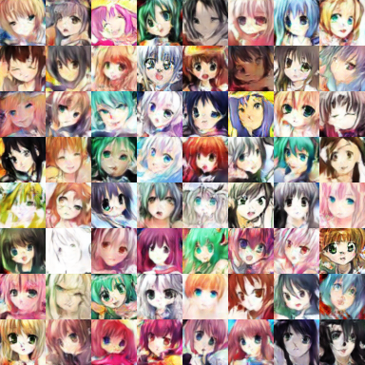
Anime Face Generation
50,000 updates

Slide 24
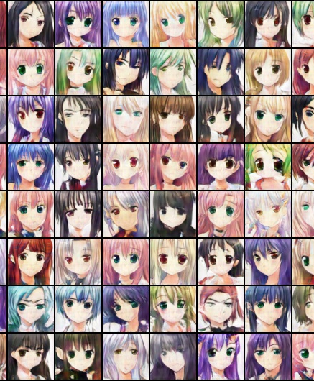
The faces generated by machine.
圖片生成：
吳宗翰、謝濬丞、
陳延昊、錢柏均
Notes:
圖片生成：
吳宗翰、謝濬丞、
陳延昊、錢柏均

Slide 25
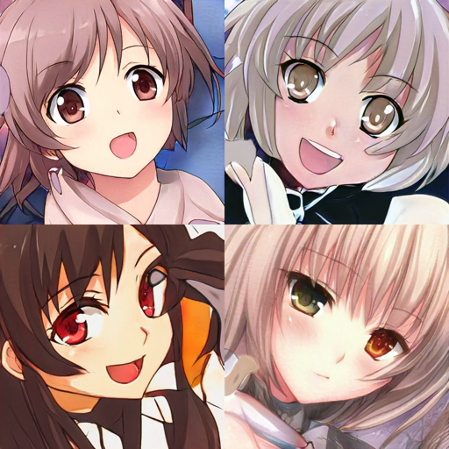
In 2019, with StyleGAN ……
Source of video:
https://www.gwern.net/Faces

Slide 26
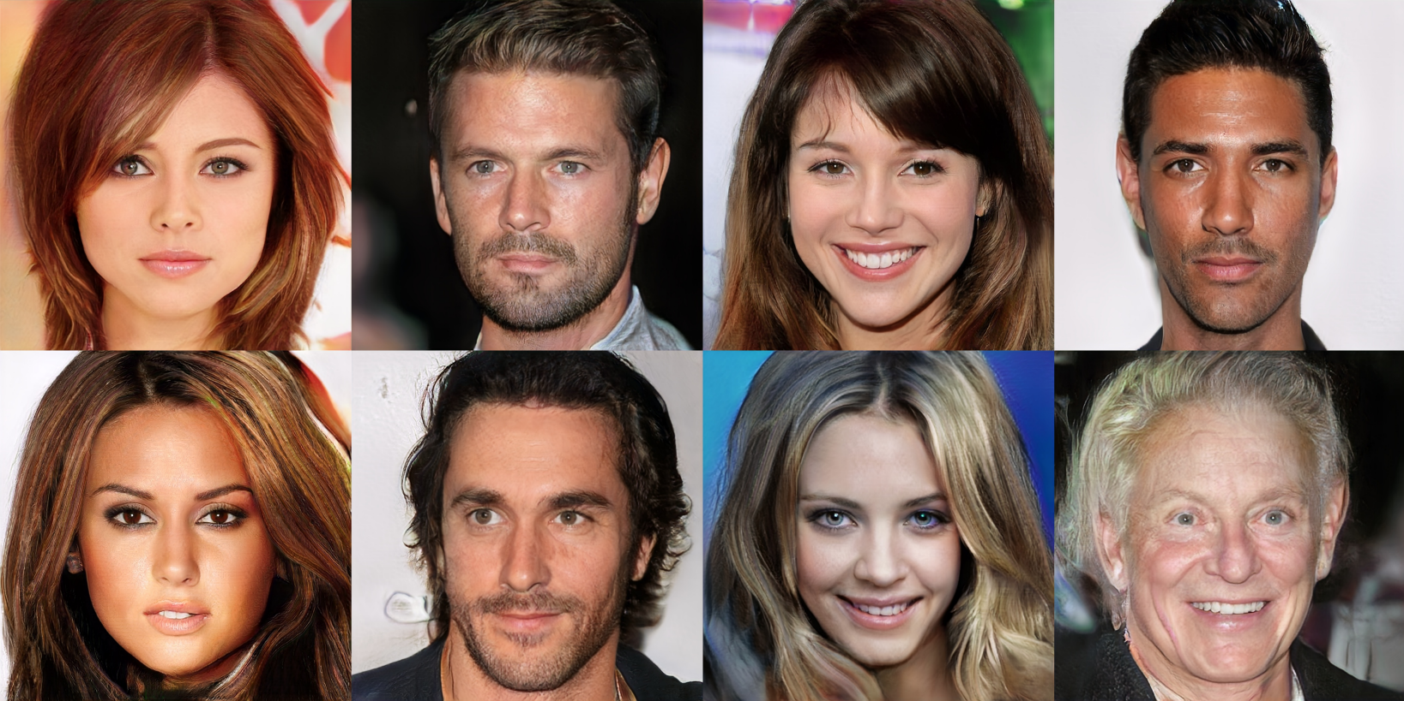
Progressive GAN
https://arxiv.org/abs/1710.10196
Notes:
Are they true?
https://apnews.com/bc2f19097a4c4fffaa00de6770b8a60d?fbclid=IwAR3eEfyonrwxEtJMdRl38xScugscwWi-_2zzoErrbpj1mPVfdEqPuq2CcY0
Is this true???

Slide 27
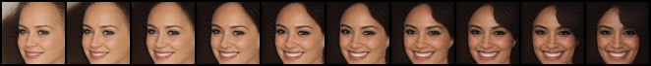

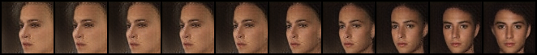
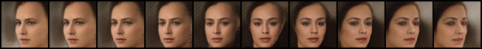

G
G
G
G
G
G
G
G
G
G
$$\left[\begin{aligned}0.0 \\ 0.0\end{aligned}\right]$$
$$\left[\begin{aligned}0.1 \\ 0.1\end{aligned}\right]$$
$$\left[\begin{aligned}0.2 \\ 0.2\end{aligned}\right]$$
$$\left[\begin{aligned}0.3 \\ 0.3\end{aligned}\right]$$
$$\left[\begin{aligned}0.4 \\ 0.4\end{aligned}\right]$$
$$\left[\begin{aligned}0.5 \\ 0.5\end{aligned}\right]$$
$$\left[\begin{aligned}0.6 \\ 0.6\end{aligned}\right]$$
$$\left[\begin{aligned}0.7 \\ 0.7\end{aligned}\right]$$
$$\left[\begin{aligned}0.8 \\ 0.8\end{aligned}\right]$$
$$\left[\begin{aligned}0.9 \\ 0.9\end{aligned}\right]$$
Notes:
感謝陳柏文同學提供實驗結果

Slide 28
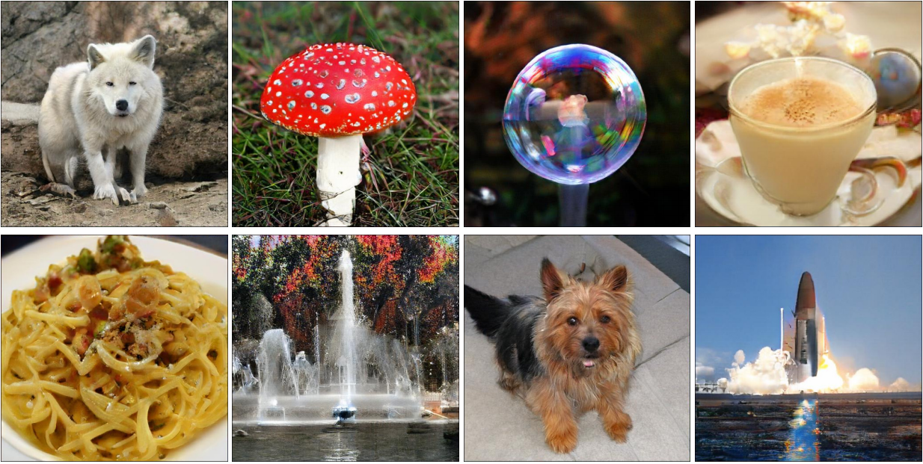
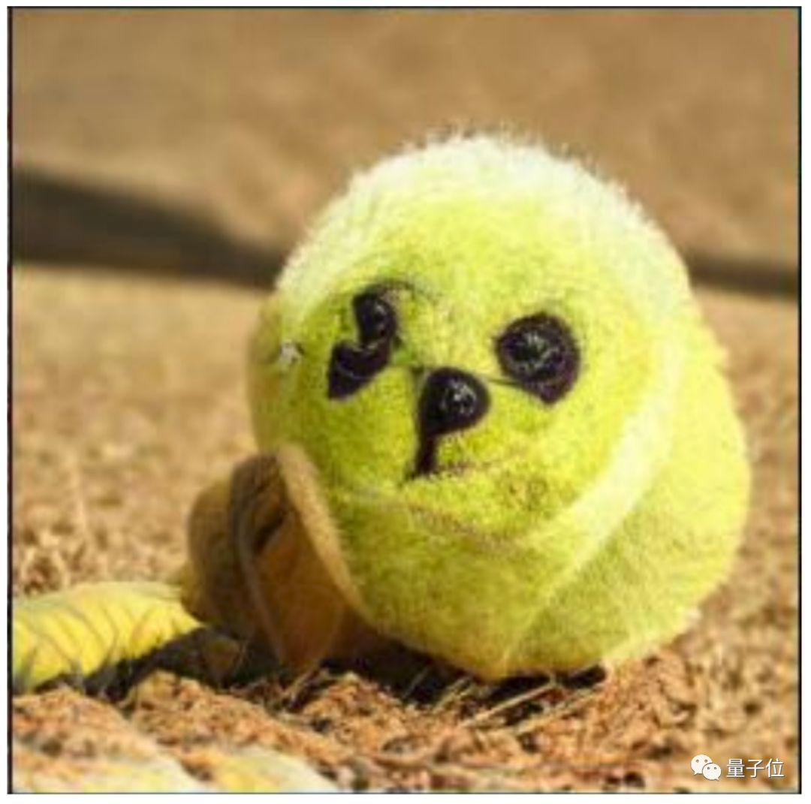

The first GAN
https://arxiv.org/abs/1406.2661
(Ian J. Goodfellow)
Notes:
Goodfellow coded into the early hours and then tested his software. It worked the first time.

Slide 29
Today …… BigGAN
https://arxiv.org/abs/1809.11096

Slide 30
Theory behind GAN

Slide 31






Our Objective
c.f.
$$w^{∗},b^{∗}=arg\min_{w,b}{L}$$
$$P_{G}$$
$$P_{data}$$
Normal Distribution
G
as close as possible
$$G^{∗}=arg\min_{G}{Div\left(P_{G},P_{data}\right)}$$
Divergence between distributions $P_{G}$ and $P_{data}$
How to compute the divergence?
Notes:
A generator G is a network. The network defines a probability distribution $P_{G}$
$x$: an image (a high-dimensional vector)

Slide 32
Sampling is good enough ……
$$G^{∗}=arg\min_{G}{Div\left(P_{G},P_{data}\right)}$$
Although we do not know the distributions of $P_{G}$ and $P_{data}$, we can sample from them.
sample
Database
Sampling from $P_{data}$
sample from normal
G
vector
vector
vector
vector
Sampling from $P_{G}$

Slide 33





Discriminator
https://arxiv.org/abs/1406.2661
$$G^{∗}=arg\min_{G}{Div\left(P_{G},P_{data}\right)}$$
: data sampled from $P_{data}$
: data sampled from $P_{G}$
Discriminator
class 1
train
Train a binary classifier
class 2
Training:
The value is related to JS divergence.
$$D^{∗}=arg\max_{D}{V\left(D,G\right)}$$
Objective Function for D
$$V\left(G,D\right)=E_{y∼P_{data}}\left[logD\left(y\right)\right]+E_{y∼P_{G}}\left[log\left(1−D\left(y\right)\right)\right]$$
$$D^{∗}=arg\max_{D}{V\left(D,G\right)}$$
Training classifier:
minimize cross entropy
=
negative cross entropy
Notes:
(G is fixed)

Slide 34
Discriminator
$$G^{∗}=arg\min_{G}{Div\left(P_{G},P_{data}\right)}$$
: data sampled from $P_{data}$
Training:
: data sampled from $P_{G}$
$$D^{∗}=arg\max_{D}{V\left(D,G\right)}$$
Discriminator
train
small divergence
hard to discriminate
Small $\max_{D}{V\left(D,G\right)}$
Discriminator
train
large divergence
easy to discriminate

Slide 35
$$G^{∗}=arg\min_{G}{Div\left(P_{G},P_{data}\right)}$$
$$\max_{D}{V\left(G,D\right)}$$
$$D^{∗}=arg\max_{D}{V\left(D,G\right)}$$
The maximum objective value is related to JS divergence.
Initialize generator and discriminator
In each training iteration:
Step 1: Fix generator G, and update discriminator D
Step 2: Fix discriminator D, and update generator G

Slide 36


Can we use other divergence?
Using the divergence you like ☺
https://arxiv.org/abs/1606.00709

Slide 37

GAN is difficult to train ……
There is a saying ……
(I found this joke from 陳柏文’s facebook.)

Slide 38
Tips for GAN

Slide 39
JS divergence is not suitable
In most cases, $P_{G}$ and $P_{data}$ are not overlapped.
1. The nature of data
2. Sampling
Both $P_{data}$ and $P_{G}$ are low-dim manifold in high-dim space.
$$P_{G}$$
$$P_{data}$$
The overlap can be ignored.
Even though $P_{data}$ and $P_{G}$ have overlap.
If you do not have enough sampling ……

Slide 40










What is the problem of JS divergence?
JS divergence is always log2 if two distributions do not overlap.
$$P_{G_{0}}$$
$$P_{data}$$
$$P_{G_{1}}$$
$$P_{data}$$
$$P_{G_{100}}$$
$$P_{data}$$
……
Equally bad
$$JS\left(P_{G_{0}},P_{data}\right)$$
$$=log2$$
$$JS\left(P_{G_{1}},P_{data}\right)$$
$$=log2$$
$$JS\left(P_{G_{100}},P_{data}\right)$$
$$=0$$
……
Intuition: If two distributions do not overlap, binary classifier achieves 100% accuracy.
Its accuracy (or loss) means nothing during GAN training.
Notes:
KL is infinite
The Jensen–Shannon divergence (JSD) {\displaystyle M_{+}^{1}(A)\times M_{+}^{1}(A)\rightarrow [0,\infty {})} is a symmetrized and smoothed version of the Kullback–Leibler divergence {\displaystyle D(P\parallel Q)}

Slide 41

Wasserstein distance
Considering one distribution P as a pile of earth, and another distribution Q as the target
The average distance the earth mover has to move the earth.
$$P$$
$$Q$$
d
$$W\left(P,Q\right)=d$$
Notes:
http://www.wxlhcc.com/product/328294.html

Slide 42


Wasserstein distance
Smaller distance?
Larger distance?
$$P$$
$$Q$$
There are many possible “moving plans”.
Using the “moving plan” with the smallest average distance to define the Wasserstein distance.
Source of image: https://vincentherrmann.github.io/blog/wasserstein/

Slide 43
What is the problem of JS divergence?
$$d_{0}$$
$$d_{1}$$
$$P_{G_{0}}$$
$$P_{data}$$
$$P_{G_{1}}$$
$$P_{data}$$
$$P_{G_{100}}$$
$$P_{data}$$
……
$$JS\left(P_{G_{0}},P_{data}\right)$$
$$=log2$$
$$JS\left(P_{G_{1}},P_{data}\right)$$
$$=log2$$
……
$$JS\left(P_{G_{100}},P_{data}\right)$$
$$=0$$
$$W\left(P_{G_{0}},P_{data}\right)$$
$$=d_{0}$$
$$W\left(P_{G_{1}},P_{data}\right)$$
$$=d_{1}$$
$$W\left(P_{G_{100}},P_{data}\right)$$
$$=0$$
……
Better!

Slide 44









What is the problem of JS divergence?
$$d_{0}$$
$$d_{1}$$
$$P_{G_{0}}$$
$$P_{data}$$
$$P_{G_{1}}$$
$$P_{data}$$
$$P_{G_{100}}$$
$$P_{data}$$
……
https://www.pnas.org/content/104/suppl_1/8567.figures-only

Slide 45
WGAN
https://arxiv.org/abs/1701.07875
Evaluate Wasserstein distance between $P_{data}$ and $P_{G}$
$$\max_{D∈1−Lipschitz}\left\{E_{x\sim P_{data}}\left[D\left(x\right)\right]−E_{x\sim P_{G}}\left[D\left(x\right)\right]\right\}$$
D has to be smooth enough.
How to fulfill this constraint?
$$∞$$
Without the constraint, the training of D will not converge.
generated
real
Keeping the D smooth forces D(x) become $∞$ and $−∞$
D
$$−∞$$
Notes:
利普希茨連
Simply speaking

Slide 46

$$\max_{D∈1−Lipschitz}\left\{E_{x\sim P_{data}}\left[D\left(x\right)\right]−E_{x\sim P_{G}}\left[D\left(x\right)\right]\right\}$$
Original WGAN $→$ Weight
Improved WGAN $→$ Gradient Penalty
Spectral Normalization $→$ Keep gradient norm smaller than 1 everywhere
Force the parameters w between c and -c
After parameter update, if w > c, w = c; if w < -c, w = -c
Keep the gradient close to 1
https://arxiv.org/abs/1704.00028
samples
https://arxiv.org/abs/1802.05957
Notes:
Spectral Normalization !!!
DraGAN (Deep Regret Analytic Generative Adversarial Networks)
Demo on toy examples
https://github.com/t-vi/pytorch-tvmisc/blob/master/wasserstein-distance/Improved_Training_of_Wasserstein_GAN.ipynb
Improved GRAGAN, SLOGAN
https://lernapparat.de/more-improved-wgan/
https://arxiv.org/pdf/1704.00028.pdf

Slide 47


GAN is still challenging …
Generator and Discriminator needs to match each other (棋逢敵手)
Notes:
寫作敵人，唸做朋友

Slide 48
GAN is still challenging …
Generate fake images to fool discriminator
Cannot fool the discriminator …
Fail to improve ...
Generator
Discriminator
Fail to improve ...
I cannot tell the difference ……
Tell the difference between real and fake

Slide 49
More Tips
Tips from Soumith
https://github.com/soumith/ganhacks
Tips in DCGAN: Guideline for network architecture design for image generation
https://arxiv.org/abs/1511.06434
Improved techniques for training GANs
https://arxiv.org/abs/1606.03498
Tips from BigGAN
https://arxiv.org/abs/1809.11096
Notes:
They also list the tips that does not work.
====
From bigGAN:
One notable side effect of this scaling is that our models reach better final performance in fewer iterations, but become unstable and undergo complete training collapse.

Slide 50







GAN for Sequence Generation
Non-differentiable …
score
unchanged
Discriminator
unchanged
機
器
學
習
max or sample
$$∆$$
$$∆$$
$$∆$$
$$∆$$
Generator
Decoder
update
$$∆$$

Slide 51

GAN for Sequence Generation
Reinforcement learning (RL) is involved ……
.
RL is difficult to train
GAN is difficult to train
Sequence Generation GAN (RL+GAN)
Notes:
Deep mind, this May

Slide 52

GAN for Sequence Generation
Usually, the generator are fine-tuned from a model learned by other approaches.
However, with enough hyperparameter-tuning and tips, ScarchGAN can train from scratch.
Training language GANs from Scratch
https://arxiv.org/abs/1905.09922
Notes:
Deep mind, this May

Slide 53

Generative Models
This lecture: Generative Adversarial Network (GAN)
Full version
https://www.youtube.com/playlist?list=PLJV_el3uVTsMq6JEFPW35BCiOQTsoqwNw

Slide 54


More Generative Models
Variational
Autoencoder (VAE)
FLOW-based Model
https://youtu.be/8zomhgKrsmQ
https://youtu.be/uXY18nzdSsM

Slide 55







Possible Solution?
$$\left[\begin{aligned}0.3 \\ −0.1 \\ ⋮ \\ −0.7\end{aligned}\right]$$
$$\left[\begin{aligned}0.1 \\ −0.1 \\ ⋮ \\ 0.7\end{aligned}\right]$$
$$\left[\begin{aligned}−0.3 \\ 0.1 \\ ⋮ \\ 0.9\end{aligned}\right]$$
$$\left[\begin{aligned}0.7 \\ 0.1 \\ ⋮ \\ −0.9\end{aligned}\right]$$
$$\left[\begin{aligned}−0.1 \\ 0.8 \\ ⋮ \\ 0.8\end{aligned}\right]$$
$$\left[\begin{aligned}0.3 \\ −0.1 \\ ⋮ \\ −0.7\end{aligned}\right]$$
Network
Using typical learning approaches?
Generative Latent Optimization (GLO), https://arxiv.org/abs/1707.05776
Gradient Origin Networks, https://arxiv.org/abs/2007.02798

Slide 56
Evaluation of Generation
Notes:
Beyond human evaluation

Slide 57
Inception Score
[Tim Salimans, et al., NIPS, 2016]
$x$: image
$y$: class (output of CNN)
class 2
Off-the-shelf Image Classifier
$$x$$
$$P\left(y|x\right)$$
class 1
class 3
e.g. Inception net, VGG, etc.
Concentrated distribution means higher visual quality
Notes:
Objective evaluation / quantitatively

Slide 58

Mode Collapse
: real data
: generated data

Slide 59



Mode Dropping
Generator switches mode during training
Mode collapse is easy to detect.
Generator
at iteration t
Generator
at iteration t+1
?
Generator
at iteration t+2
BEGAN on CelebA
Notes:
Beige skin KK[beʒ]
Dark skin

Slide 60







CNN
$$P\left(y\right)=\frac{1}{N}\sum_{n}{P\left(y^{n}|x^{n}\right) }$$
$$x^{1}$$
$$P\left(y^{1}|x^{1}\right)$$
$$x^{2}$$
CNN
$$P\left(y^{2}|x^{2}\right)$$
$$x^{3}$$
CNN
Uniform distribution means higher variety
$$P\left(y^{3}|x^{3}\right)$$
…
60

Slide 61


Inception Score
$$P\left(y\right)=\frac{1}{N}\sum_{n}{P\left(y^{n}|x^{n}\right) }$$
$$P\left(y|x\right)$$
class 2
class 1
class 3
Inception Score
[Tim Salimans, et al., NIPS 2016]
$$=\sum_{x}{\sum_{y}{P\left(y|x\right)logP\left(y|x\right)}}$$
Negative entropy of P(y|x)
$$−\sum_{y}{P\left(y\right)logP\left(y\right)}$$
Entropy of P(y)
Notes:
Probably I have to provide an example here
Tim Salimans, Ian Goodfellow, Wojciech Zaremba, Vicki Cheung, Alec Radford, Xi Chen, “Improved Techniques for Training GANs”, arXiv prepring, 2016

Slide 62
Fréchet Inception Distance (FID)
https://arxiv.org/pdf/1706.08500.pdf
FID =
Fréchet distance between the two Gaussians
red points: latent representation of Inception net for the real images
blue points: latent representation of Inception net for the generated images
Notes:
[Martin Heusel, et al., NIPS, 2017]

Slide 63


FIT: Smaller is better
Are GANs Created Equal? A Large-Scale Study
https://arxiv.org/abs/1711.10337

Slide 64
We don’t want memory GAN.
https://arxiv.org/pdf/1511.01844.pdf
Using k-nearest neighbor to check whether the generator generates new objects
Notes:
reverse

Slide 65

To learn more about evaluation …
Pros and cons of GAN evaluation measures
https://arxiv.org/abs/1802.03446

Slide 66
Concluding Remarks
Introduction of Generative Models
Generative Adversarial Network (GAN)
Theory behind GAN
Tips for GAN
Evaluation of Generative Models

Slide 67


